Slide 1
Should we fear God or love him?
Micah 1-2
p930

Slide 2
Old Testament
Jesus

Slide 3
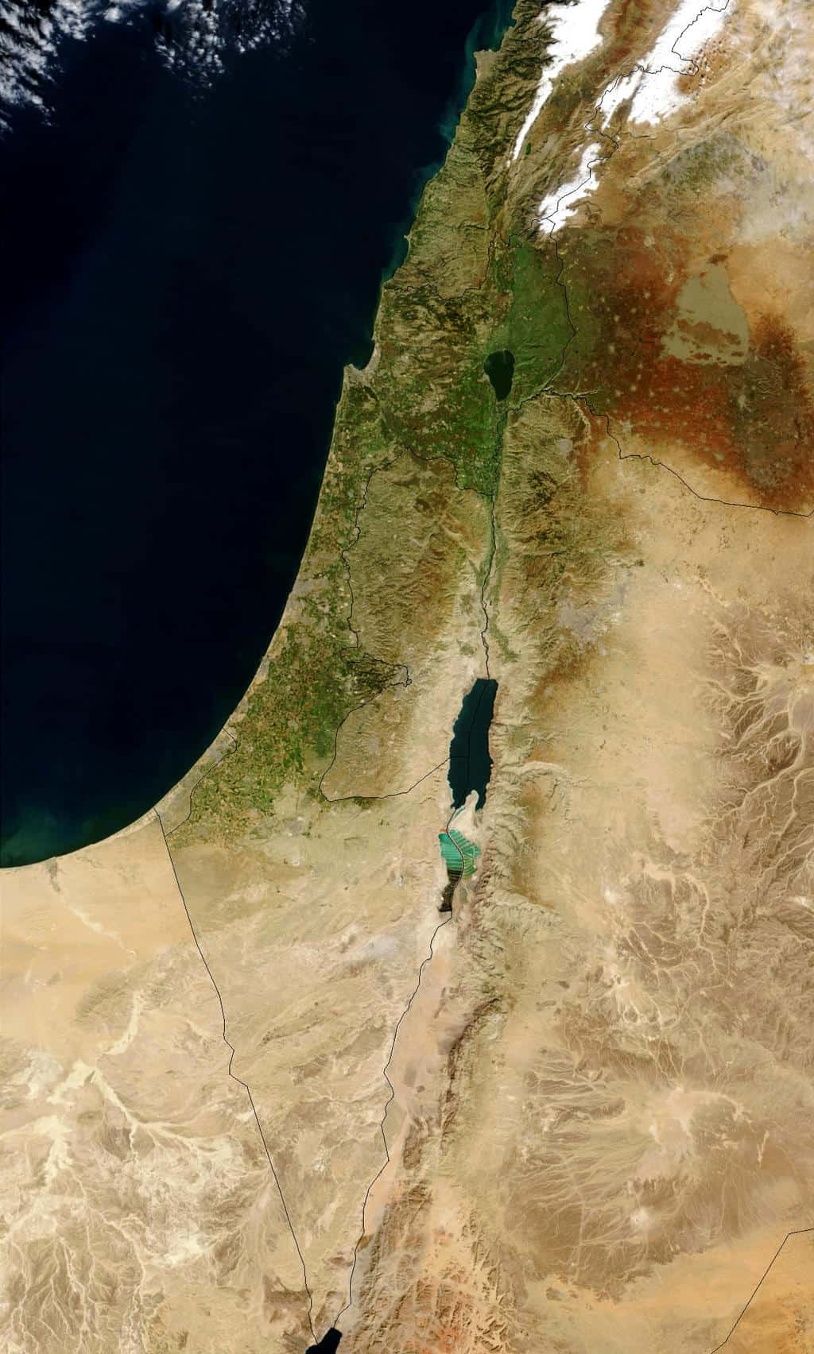
Samaria
-------------
Jerusalem

Slide 4
A God to fear
- The northern kingdom (1:1-7)

Slide 5
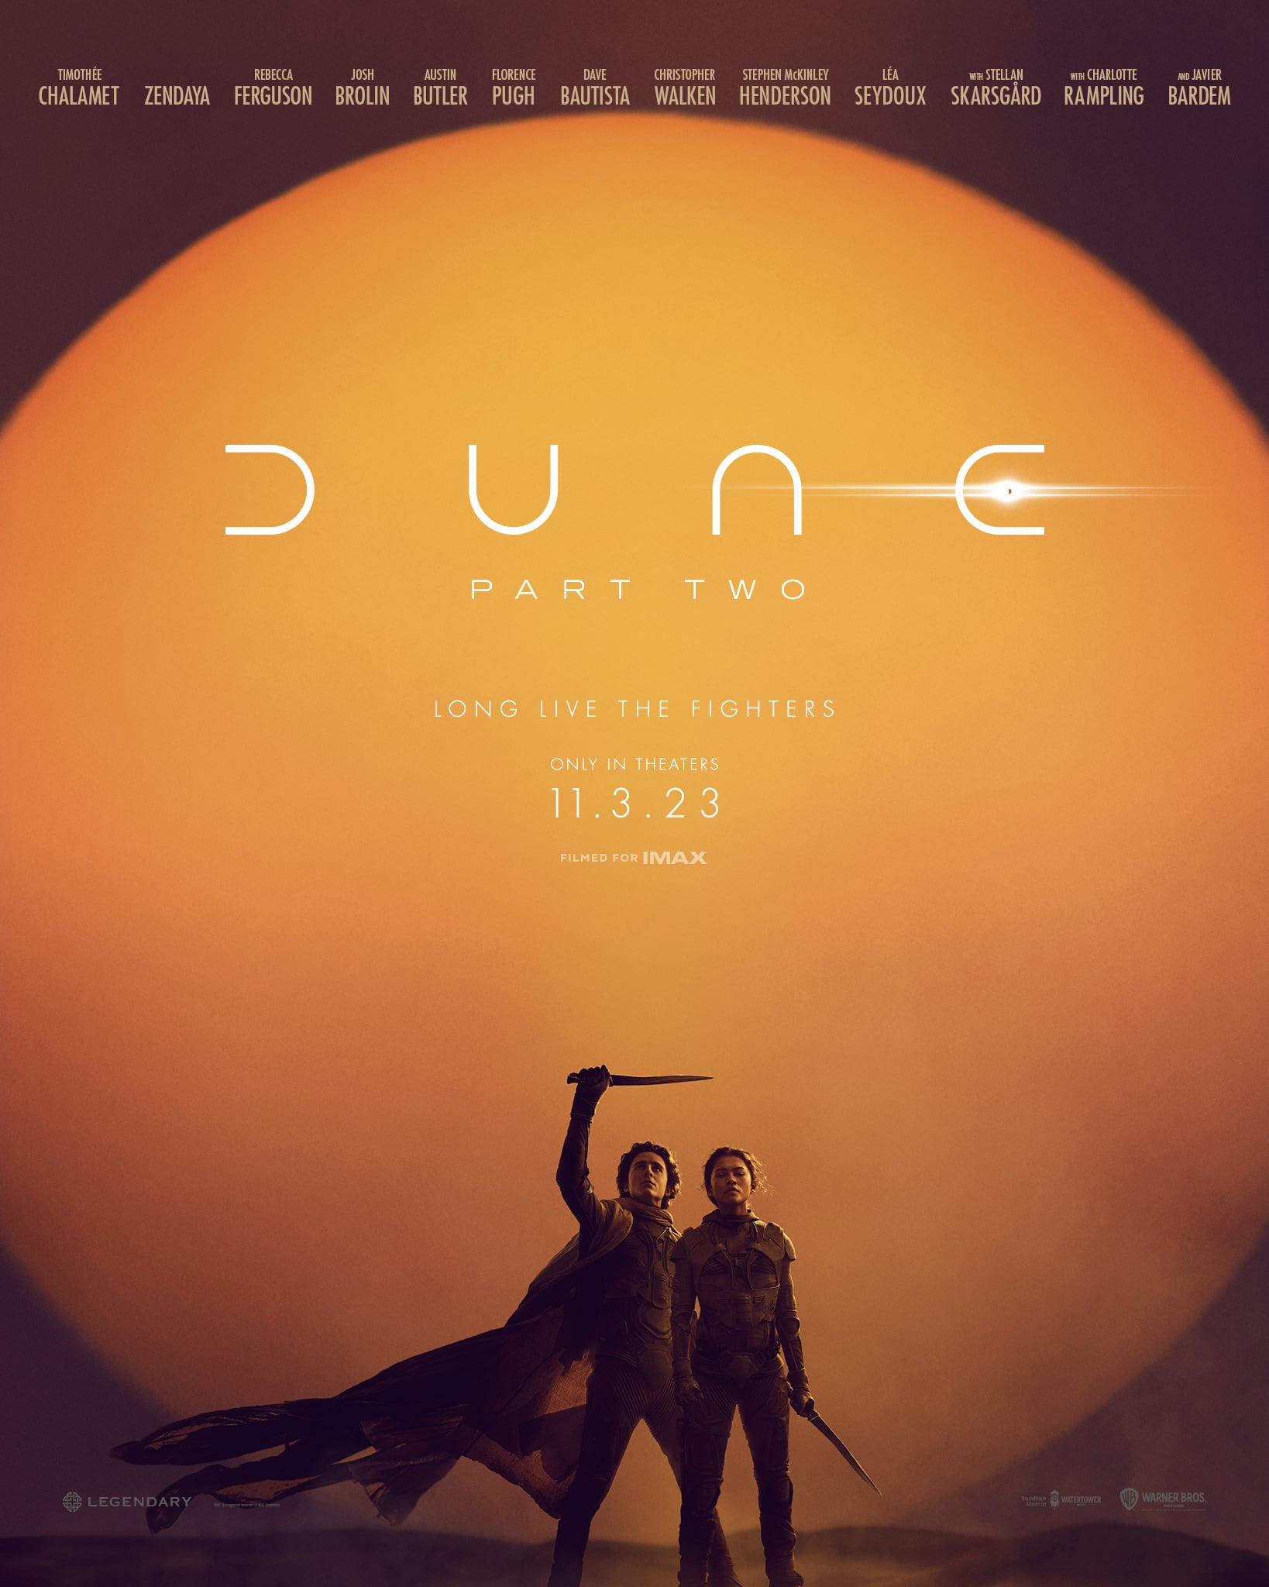

Slide 6
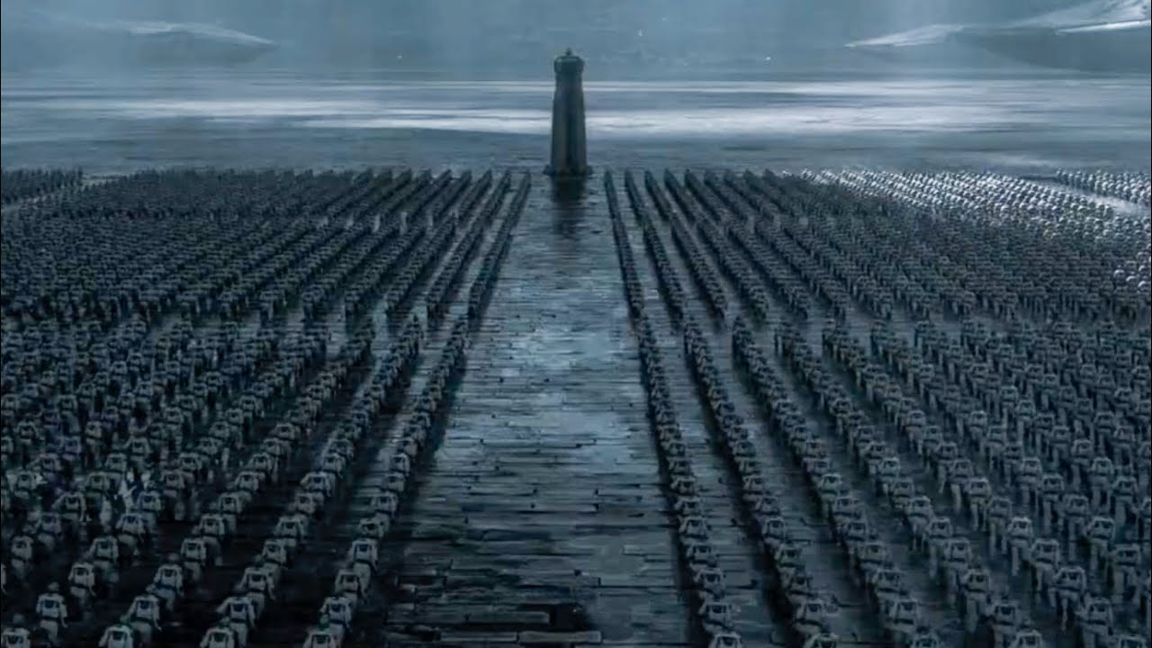

Slide 7
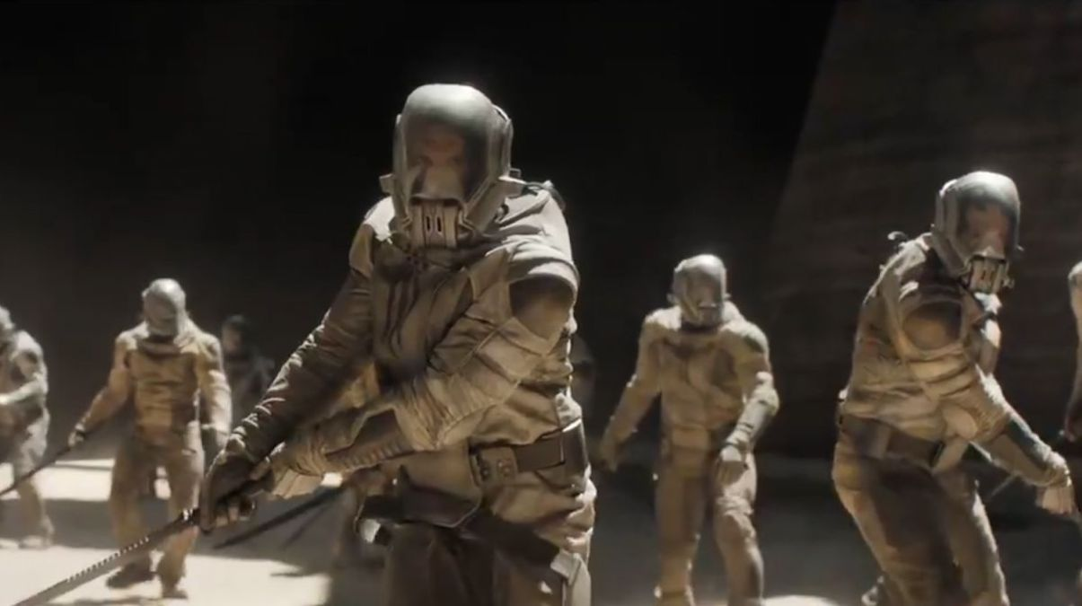

Slide 8
Samaria
-------------
Jerusalem

Slide 9
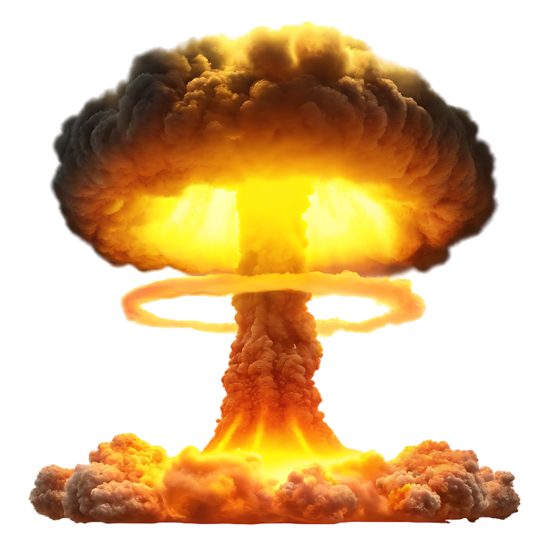
-------------
Jerusalem

Slide 10
A God to fear
- The northern kingdom (1:1-7)

Slide 11
A God to fear
- The northern kingdom (1:1-7)
- The southern kingdom (1:8 – 2:11)

Slide 12
-------------
Jerusalem

Slide 13
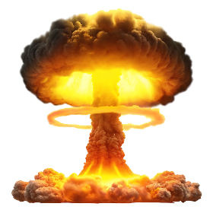
-------------
Jerusalem

Slide 14
A God to fear
- The northern kingdom (1:1-7)
- The southern kingdom (1:8 – 2:11)

Slide 15
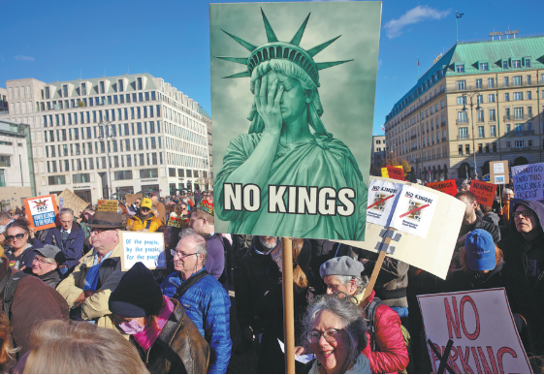

Slide 16
A God to fear
- The northern kingdom (1:1-7)
- The southern kingdom (1:8 – 2:11)

Slide 17
A God to fear
- The northern kingdom (1:1-7)
- The southern kingdom (1:8 – 2:11)
A God to love (2:12-13)

Slide 18
-------------
Jerusalem

Slide 19
A God to fear
- The northern kingdom (1:1-7)
- The southern kingdom (1:8 – 2:11)
A God to love (2:12-13)

